Slide 1
Design and Analysis of Algorithms
Algorithms-II : CS345A
Website: hello.iitk.ac.in
Lecture 23
Network Flow – IV
Polynomial time algorithms for Maximum Flow

Slide 2
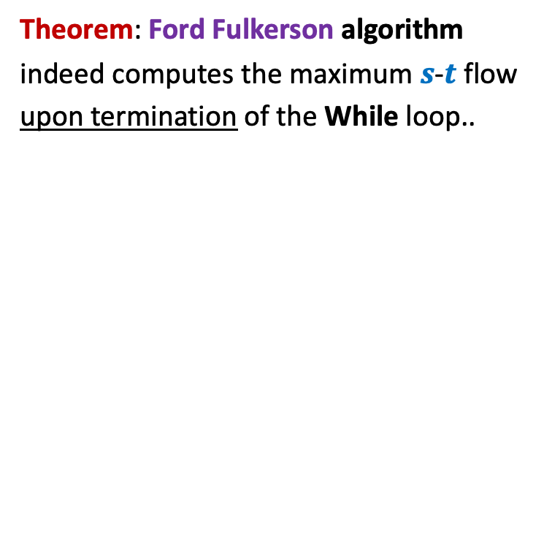
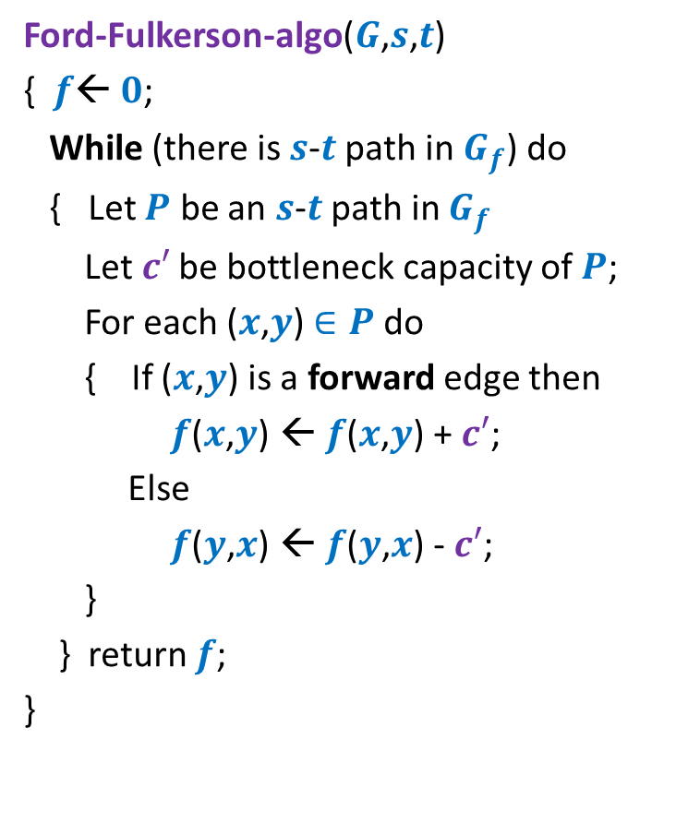
Ford Fulkerson algorithm
Ford-Fulkerson-algo($G$,$s$,$t$)
{ $f$← $0$;
While (there is $s$-$t$ path in $G_{f}$) do
{ Let $P$ be an $s$-$t$ path in $G_{f}$
Let$c′$ be bottleneck capacity of $P$;
For each ($x$,$y$) $∈P$ do
{ If ($x$,$y$) is a forward edge then
$f$($x$,$y$) ← $f$($x$,$y$) + $c′$;
Else
$f$($y$,$x$) ← $f$($y$,$x$) - $c′$;
}
} return $f$;
}
Theorem: Ford Fulkerson algorithm
indeed computes the maximum $s$-$t$ flow
upon termination of the While loop..
Time complexity ?

Slide 3
Integrality of max-flow
A useful tool for many applications of Max-Flow

Slide 4




Integrality of max-flow
Theorem: Given a network $G$=($V$,$E$), and two vertices $s$,$t∈V$,
if edge capacities are integers, then there exists a maximum $s$-$t$flow $f$
which is “integral”.
$f\left(e\right)∈Z$for each $e∈E$
1
.67
1
.67
1
1
1
$$s$$
1
.33
$$t$$
0
.33
0
1
1

Slide 5
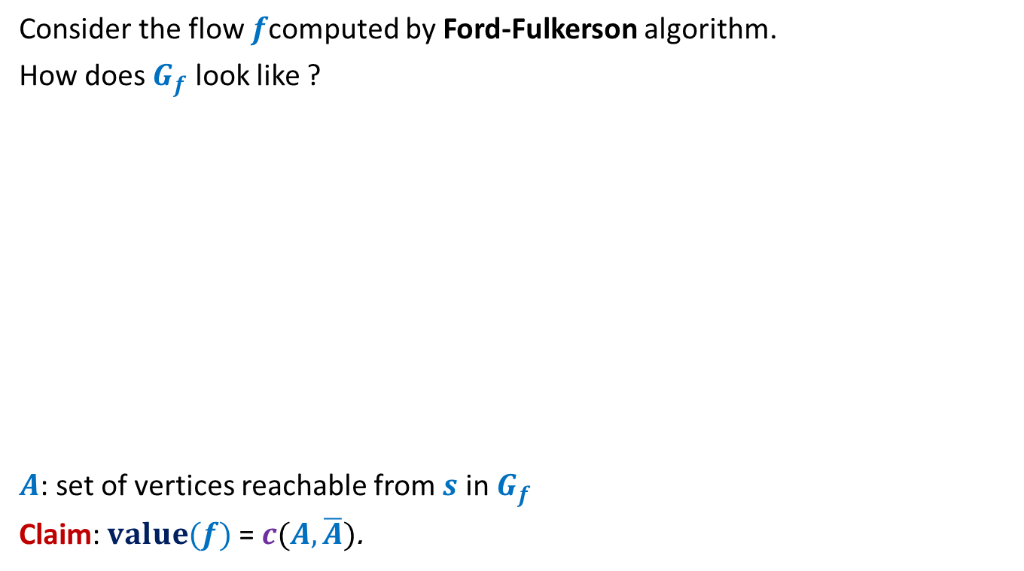
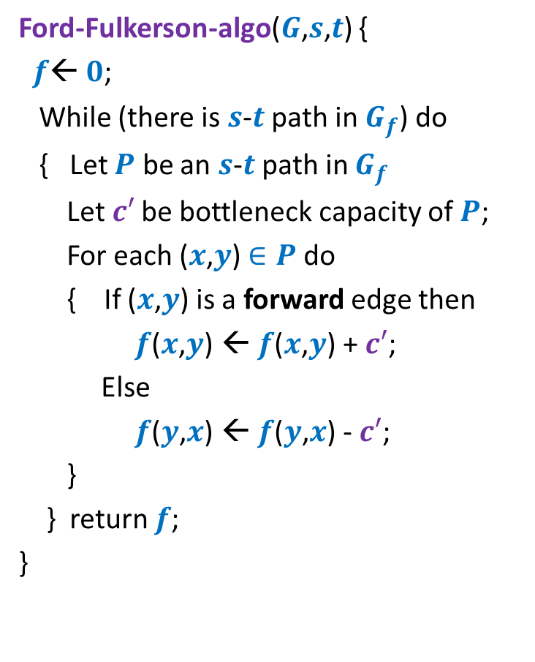
Proof for Integrality theorem
Ford-Fulkerson-algo($G$,$s$,$t$) {
$f$← $0$;
While (there is $s$-$t$ path in $G_{f}$) do
{ Let $P$ be an $s$-$t$ path in $G_{f}$
Let$c′$ be bottleneck capacity of $P$;
For each ($x$,$y$) $∈P$ do
{ If ($x$,$y$) is a forward edge then
$f$($x$,$y$) ← $f$($x$,$y$) + $c′$;
Else
$f$($y$,$x$) ← $f$($y$,$x$) - $c′$;
}
} return $f$;
}
Claim:
Ford Fulkerson algorithm computes a maximum flow which is integral.
Proof: (By induction on the no. of iteration)
Inductive Assertion:
At the end of $i$th iteration, $f$ is integral.
[Homework: give all details of the proof].
In fact, the statement can be shown to hold for any flow (not necessary max flow) $f$whose value is an integer.
Hint: In each iteration send only 1 unit of flow instead of $c′$.

Slide 6
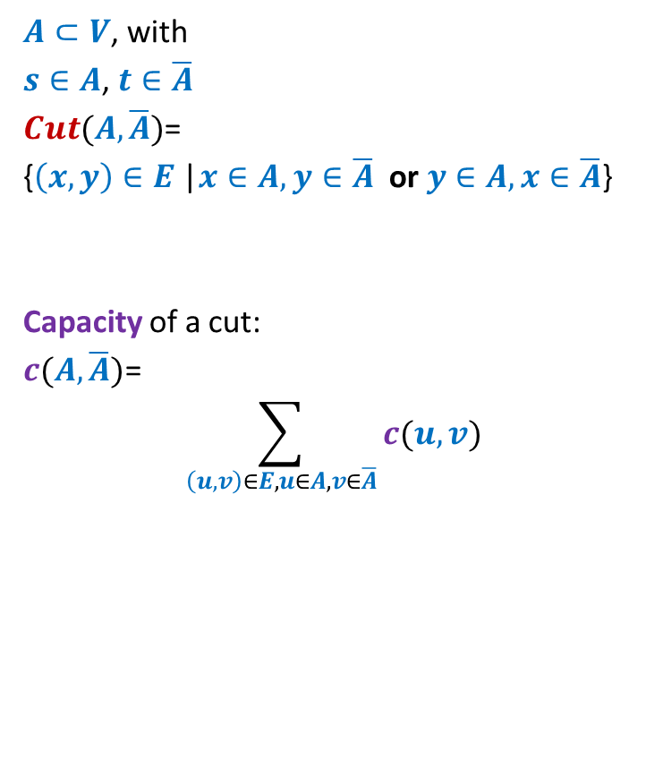
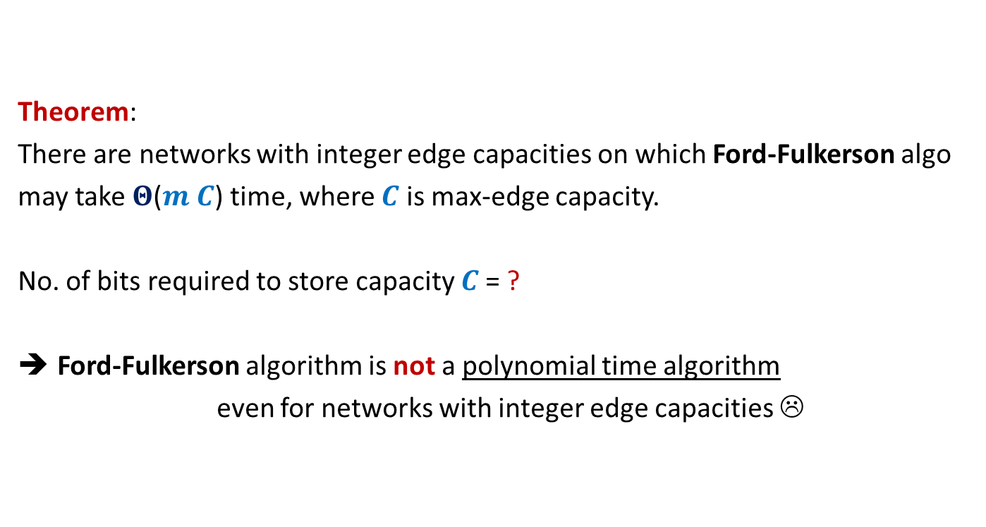

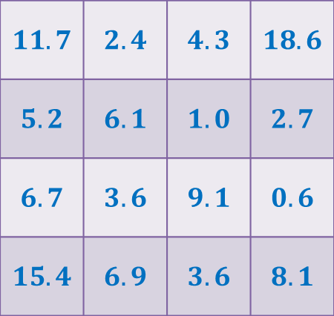

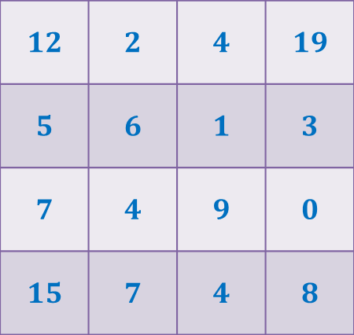
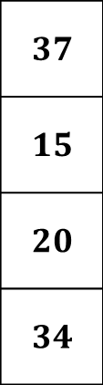

Rounding of a matrix
$$11$$
$$11.7$$
$$12$$
$$39$$ | $$19$$ | $$18$$ | $$30$$
$$37$$
$$15$$
$$20$$
$$34$$
$$11.7$$ | $$2.4$$ | $$4.3$$ | $$18.6$$
$$5.2$$ | $$6.1$$ | $$1.0$$ | $$2.7$$
$$6.7$$ | $$3.6$$ | $$9.1$$ | $$0.6$$
$$15.4$$ | $$6.9$$ | $$3.6$$ | $$8.1$$
$$12$$ | $$2$$ | $$4$$ | $$19$$
$$5$$ | $$6$$ | $$1$$ | $$3$$
$$7$$ | $$4$$ | $$9$$ | $$0$$
$$15$$ | $$7$$ | $$4$$ | $$8$$
Design an algorithm to round a $n×n$ matrix, if possible ?
Do it as a homework. You know all the basic tools to solve this problem.

Slide 7
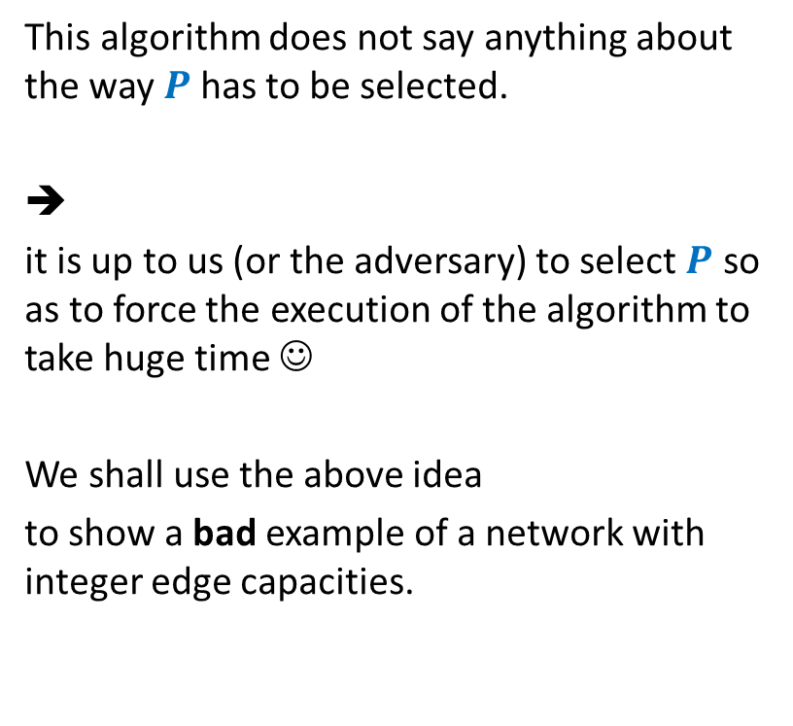
Ford Fulkerson algorithm
Ford-Fulkerson-algo($G$,$s$,$t$)
{ $f$← $0$;
While (there is $s$-$t$ path in $G_{f}$) do
{ Let $P$ be an $s$-$t$ path in $G_{f}$
Let$c′$ be bottleneck capacity of $P$;
For each ($x$,$y$) $∈P$ do
{ If ($x$,$y$) is a forward edge then
$f$($x$,$y$) ← $f$($x$,$y$) + $c′$;
Else
$f$($y$,$x$) ← $f$($y$,$x$) - $c′$;
}
} return $f$;
}
This algorithm does not say anything about the way $P$has to be selected.
➔
it is up to us (or the adversary) to select $P$ so as to force the execution of the algorithm to take huge time ☺
We shall use the above idea
to show a bad example of a network with integer edge capacities.

Slide 8










A worst case example for networks with integer edge weights
$$G$$
$$G_{f}$$
$$x$$
$$x$$
1
1000
1000
1000
1000
$$s$$
1
1
$$t$$
$$s$$
1
$$t$$
1
1000
1000
1000
1000
$$y$$
$$y$$

Slide 9
A worst case example for networks with integer edge weights
$$G$$
$$G_{f}$$
$$x$$
$$x$$
1
1
1
1000
999
1000
1000
$$s$$
1
1
$$t$$
$$s$$
1
$$t$$
1
1
1000
1000
1000
999
1
$$y$$
$$y$$

Slide 10
A worst case example for networks with integer edge weights
$$G$$
$$G_{f}$$
$$x$$
$$x$$
1
1
1
1
2
1000
999
1000
999
$$s$$
1
1
$$t$$
$$s$$
1
$$t$$
1
2
1
1000
1000
999
999
1
1
$$y$$
$$y$$
The algorithm will run for 2000 iterations to compute max-flow !

Slide 11
A worst case example for networks with integer edge weights
$$G$$
$$G_{f}$$
$$x$$
$$x$$
1
1
1
1
2
1000
999
1000
999
$$s$$
1
1
$$t$$
$$s$$
1
$$t$$
1
2
1
1000
1000
999
999
1
1
$$y$$
$$y$$

Slide 12

Theorem:
There are networks with integer edge capacities on which Ford-Fulkerson algo
may take $Θ$($m C$) time, where $C$ is max-edge capacity.
No. of bits required to store capacity $C$= ?
Ford-Fulkerson algorithm is not a polynomial time algorithm
even for networks with integer edge capacities ☹
$$\log_{2}C$$

Slide 13
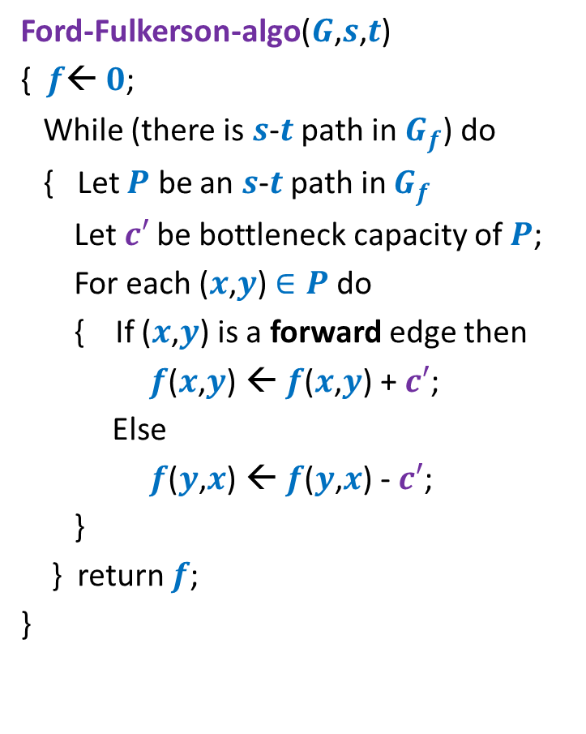
Ford Fulkerson algorithm
Ford-Fulkerson-algo($G$,$s$,$t$)
{ $f$← $0$;
While (there is $s$-$t$ path in $G_{f}$) do
{ Let $P$ be an $s$-$t$ path in $G_{f}$
Let$c′$ be bottleneck capacity of $P$;
For each ($x$,$y$) $∈P$ do
{ If ($x$,$y$) is a forward edge then
$f$($x$,$y$) ← $f$($x$,$y$) + $c′$;
Else
$f$($y$,$x$) ← $f$($y$,$x$) - $c′$;
}
} return $f$;
}
Polynomial time algorithm ?

Slide 14
Polynomial time algorithms for Max-Flow
A natural question: How to achieve polynomial running time ?
➔
A natural idea:
Select the path of maximum capacity.
select the paths in Ford-Fulkerson algorithm cleverly

Slide 15
Polynomial Time algorithms for max-flow
Algorithm 1 For Networks with integer capacities

Slide 16


Algorithm 1
Algorithm-1($G$,$s$,$t$) {
Ford-Fulkerson-algo($G$,$s$,$t$) {
$f$← $0$;
While (there is $s$-$t$ path in $G_{f}$) do
{ Let $P$ be an $s$-$t$ path in $G_{f}$
Let$c′$ be bottleneck capacity of $P$;
For each ($x$,$y$) $∈P$ do
{ If ($x$,$y$) is a forward edge then
$f$($x$,$y$) ← $f$($x$,$y$) + $c′$;
Else
$f$($y$,$x$) ← $f$($y$,$x$) - $c′$;
}
} return $f$;
}
Let $P$ be the max-capacity $s$-$t$ path in $G_{f}$;

Slide 17
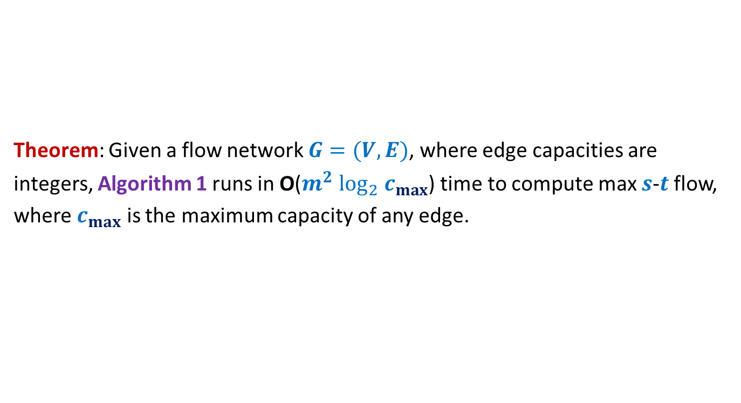
Algorithm 1
Theorem: Given a flow network $G=(V,E)$, where edge capacities are
integers, Algorithm 1 runs in O($m^{2} \log_{2} c_{max}$) time to compute max $s$-$t$ flow,
where $c_{max}$ is the maximum capacity of any edge.

Slide 18

Polynomial Time algorithm for max-flow
Algorithm 2
For Networks with edge capacities $∈R^{+}$

Slide 19
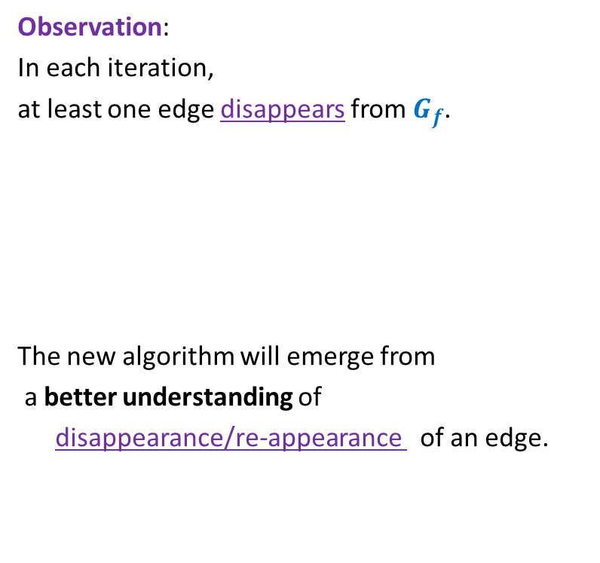

Ford Fulkerson Algorithm
Ford-Fulkerson-algo($G$,$s$,$t$) {
$f$← $0$;
While (there is $s$-$t$ path in $G_{f}$) do
{ Let $P$ be an $s$-$t$ path in $G_{f}$
Let$c′$ be bottleneck capacity of $P$;
For each ($x$,$y$) $∈P$ do
{ If ($x$,$y$) is a forward edge then
$f$($x$,$y$) ← $f$($x$,$y$) + $c′$;
Else
$f$($y$,$x$) ← $f$($y$,$x$) - $c′$;
}
} return $f$;
}
Observation:
In each iteration,
at least one edge disappears from $G_{f}$.
The new algorithm will emerge from
a better understanding of
disappearance/re-appearance of an edge.
But it may appear in $G_{f}$ again.

Slide 20

Disappearance of an edge in $G_{f}$

Slide 21












Disappearance of a forward edge
Flow must have increased along edge ($x$,$y$) up to $c$($x$,$y$).
➔ ($x$,$y$) must belong to the path $P$ selected during $i$th Iteration.
$$x$$
$$y$$
$$s$$
$$t$$
$$G_{f}$$
$$x$$
$$y$$
After $i$th Iteration
$$x$$
$$y$$
$$s$$
$$t$$
$$G_{f′}$$
$$x$$
$$y$$

Slide 22







Disappearance of a backward edge
Flow must have decreased along edge ($y$,$x$) to 0.
➔ ($x$,$y$) must belong to the path $P$ selected during $i$th Iteration.
$$y$$
$$x$$
$$s$$
$$t$$
$$G_{f}$$
$$x$$
$$y$$
After $i$th Iteration
$$y$$
$$x$$
$$s$$
$$t$$
$$G_{f′}$$
$$x$$
$$y$$

Slide 23
the (RE-)appearance of an edge

Slide 24










(Re)-Appearance of a forward edge
Flow must have reduced along edge ($x$,$y$) to less than $c$($x$,$y$).
➔ ($y$,$x$) must belong to the path $P$ selected during $i$th Iteration.
$$x$$
$$y$$
$$s$$
$$t$$
$$G_{f}$$
$$x$$
$$y$$
After $i$th Iteration
$$x$$
$$y$$
$$s$$
$$t$$
$$G_{f′}$$
$$x$$
$$y$$

Slide 25


(Re)-appearance of a backward edge
Flow must have increased along edge ($y$,$x$).
➔ ($y$,$x$) must belong to the path $P$ selected during $i$th Iteration.
$$y$$
$$x$$
$$s$$
$$t$$
$$G_{f}$$
$$x$$
$$y$$
After $i$th Iteration
$$y$$
$$x$$
$$s$$
$$t$$
$$G_{f′}$$
$$x$$
$$y$$

Slide 26
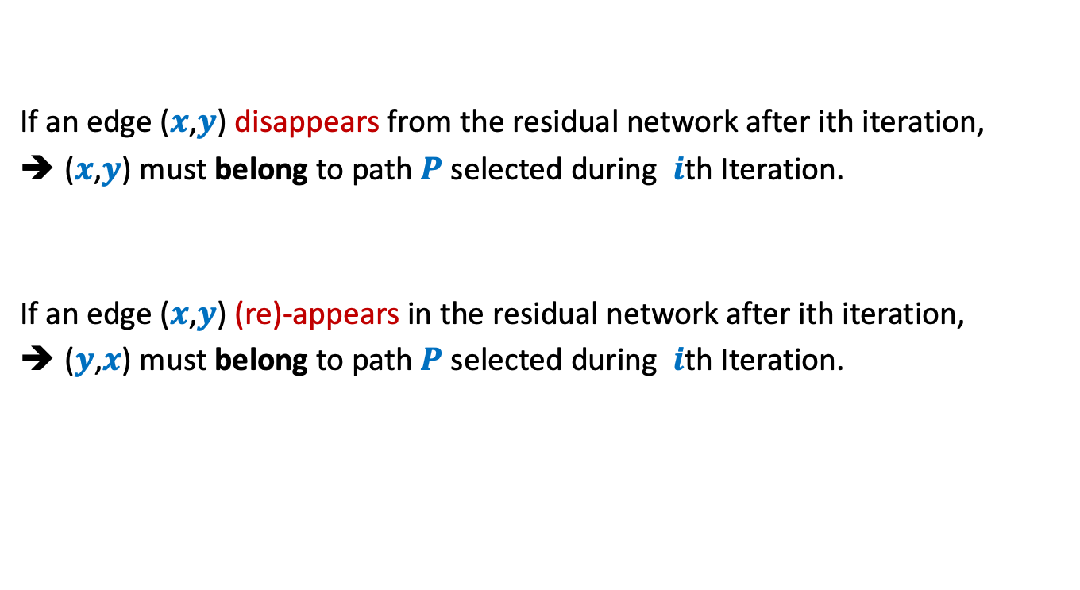
Disappearance/Reappearance of an edge in residual network
If an edge ($x$,$y$) disappears from the residual network after ith iteration,
($x$,$y$) must belong to path $P$ selected during $i$th Iteration.
If an edge ($x$,$y$) (re)-appears in the residual network after ith iteration,
($y$,$x$) must belong to path $P$ selected during $i$th Iteration.

Slide 27



Algorithm 2
Ford-Fulkerson-algo($G$,$s$,$t$) {
$f$← $0$;
While (there is $s$-$t$ path in $G_{f}$) do
{ Let $P$ be an $s$-$t$ path in $G_{f}$
Let$c′$ be bottleneck capacity of $P$;
For each ($x$,$y$) $∈P$ do
{ If ($x$,$y$) is a forward edge then
$f$($x$,$y$) ← $f$($x$,$y$) + $c′$;
Else
$f$($y$,$x$) ← $f$($y$,$x$) - $c′$;
}
} return $f$;
}
Algorithm-2($G$,$s$,$t$) {
In each iteration, at least one edge disappears from $G_{f}$.
This algorithm ensures that an edge can disappear and re-appear O($n$) times.
Let $P$ be the shortest $s$-$t$ path in $G_{f}$;
How to modify the FF algorithm so that the number of times an edge disappears has a polynomial bound ?

Slide 28

Algorithm 2
Ford-Fulkerson-algo($G$,$s$,$t$) {
$f$← $0$;
While (there is $s$-$t$ path in $G_{f}$) do
{ Let $P$ be an $s$-$t$ path in $G_{f}$
Let$c′$ be bottleneck capacity of $P$;
For each ($x$,$y$) $∈P$ do
{ If ($x$,$y$) is a forward edge then
$f$($x$,$y$) ← $f$($x$,$y$) + $c′$;
Else
$f$($y$,$x$) ← $f$($y$,$x$) - $c′$;
}
} return $f$;
}
Algorithm-2($G$,$s$,$t$) {
Let $P$ be the shortest $s$-$t$ path in $G_{f}$;
How to prove:
An edge can disappear and re-appear O($n$) times.

Slide 29







A crucial observation
Lemma : Distance from $s$ to each vertex increases monotonically in $G_{f}$.
$$δ_{f}\left(s,x\right)≤δ_{f′}\left(s,x\right)$$
$$δ_{f}(s,x)$$
$$s$$
$$t$$
$$x$$
$$G_{f}$$
After $i$th Iteration
$$δ_{f′}(s,x)$$
$$s$$
$$t$$
$$G_{f′}$$
$$x$$

Slide 30
Homework
Ponder over the proof of lemma and try to use it to analyse the new algorithm.
We shall discuss it in the next lecture …

